Slide 1
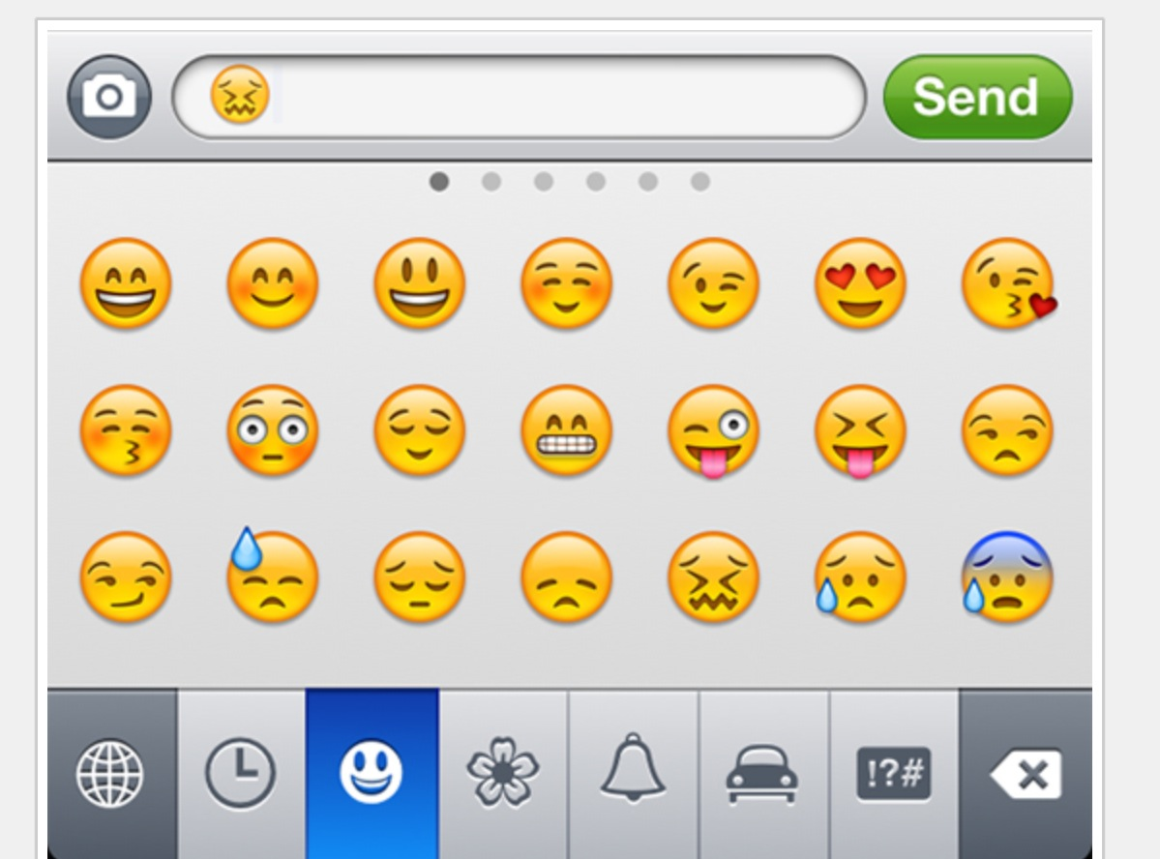
In reality sentiment is more complex.
Many Many Emoji

Slide 2
How should you deal with emojis?
Remove unknown?
Substitute for known text
Open Script

Slide 3
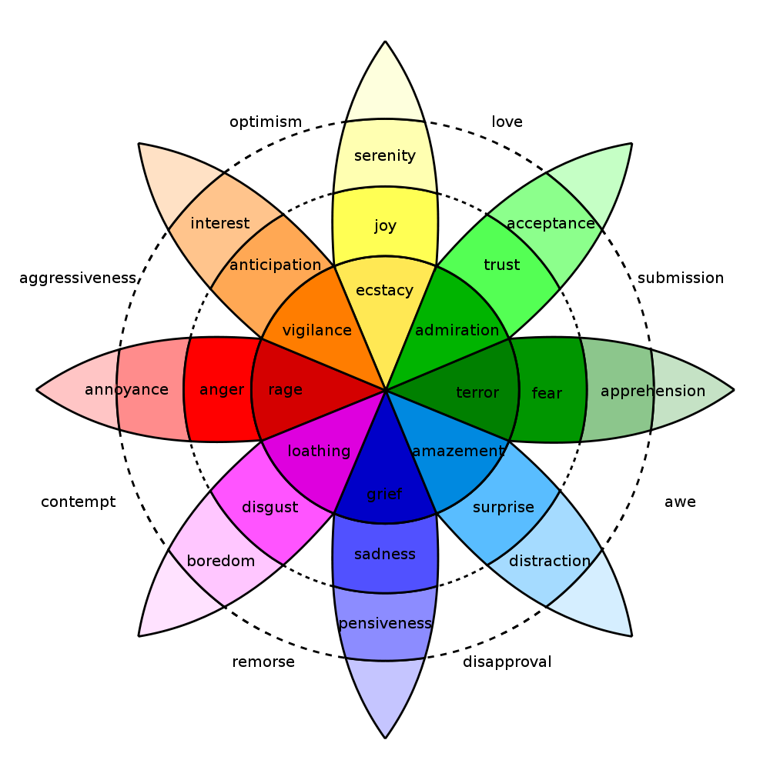
In reality sentiment is more complex.
Many Many Emoji

Slide 4
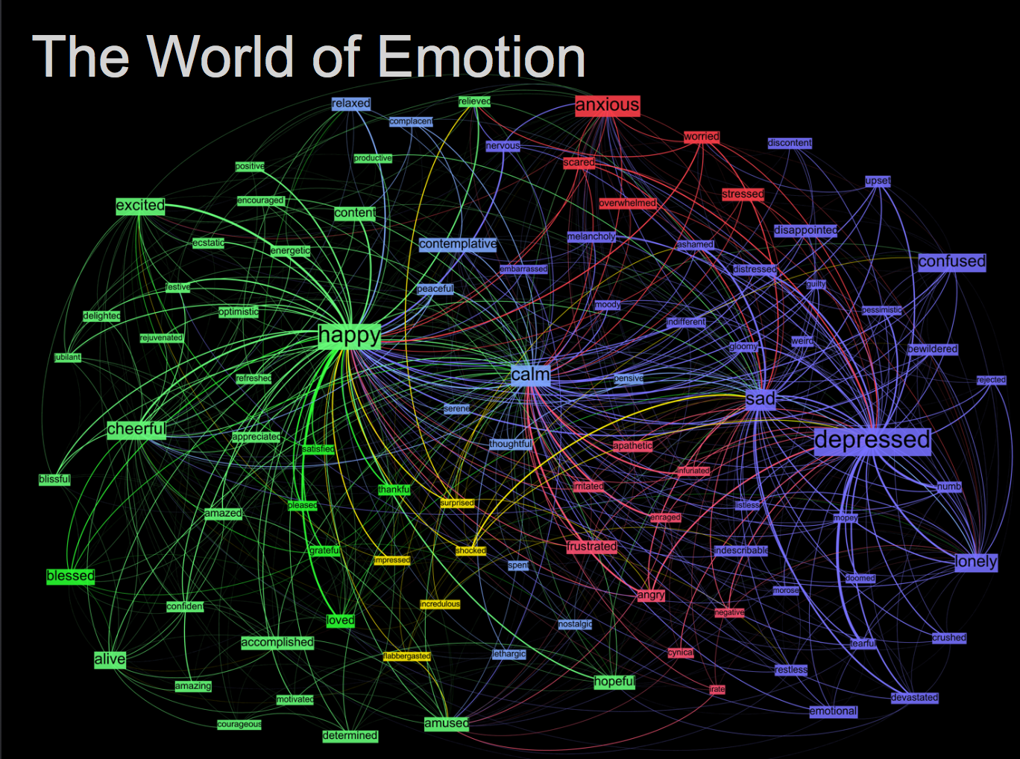
Kanjoya’s Experience Corpus

Slide 5
Tidy Data Formats are structured differently
Tidy Form (Triplet, Dense Data)
Document Term Matrix
Document | Term | count
Tweet1 | Term2 | 1
Twee1 | term3 | 1
Tweet2 | Term2 | 1
Tweet3 | Term… | 3
Tweet… | Term… | 1
Tweet… | Term_n | 1
Tweet_n | Term… | 1
 | Term1 | Term2 | Term3 | … | Term_n
Tweet1 | 0 | 1 | 1 | 0 | 0
Tweet2 | 0 | 1 | 0 | 0 | 0
Tweet3 | 0 | 0 | 0 | 3 | 0
… | 0 | 0 | 0 | 1 | 1
Tweet_n | 0 | 0 | 0 | 1 | 0
Sparse Data: Memory used to hold 0s
Dense Data: Efficient in Memory

Slide 6

The pipe operator…%>%

Slide 7
Tidy data uses %>% to forward objects
In the “tidyverse” code is structured so it is more easily read using the %>%. The data format is a tibble usually not a data frame.
mtcars
mtcars %>% group_by(cyl)
mtcars %>% group_by(cyl) %>% mutate(rank = min_rank(desc(mpg)))
This reads as “Using the mtcars object then group by the cyl vector then mutate a new variable called rank.

Slide 8
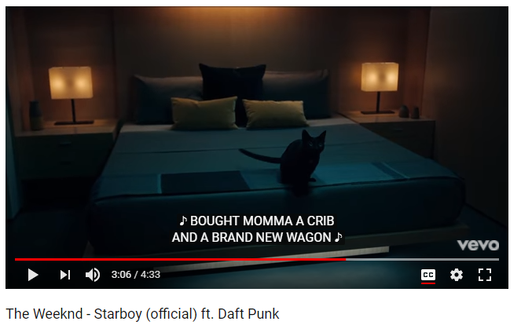
In this exercise we will examine song lyrics

Slide 9
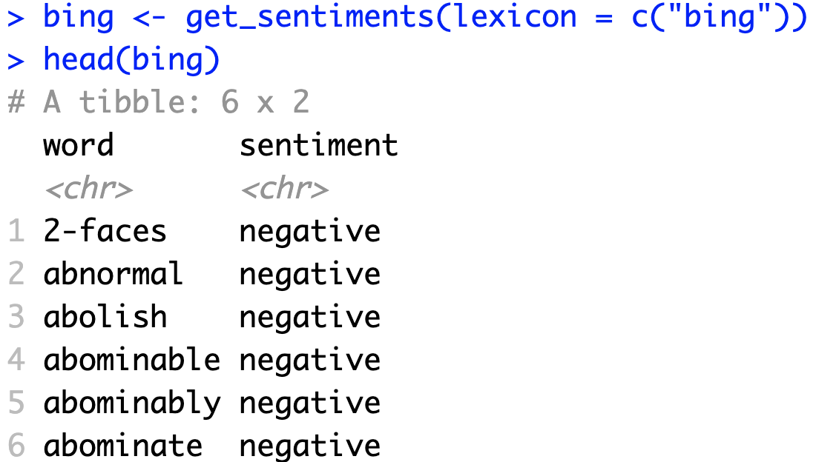
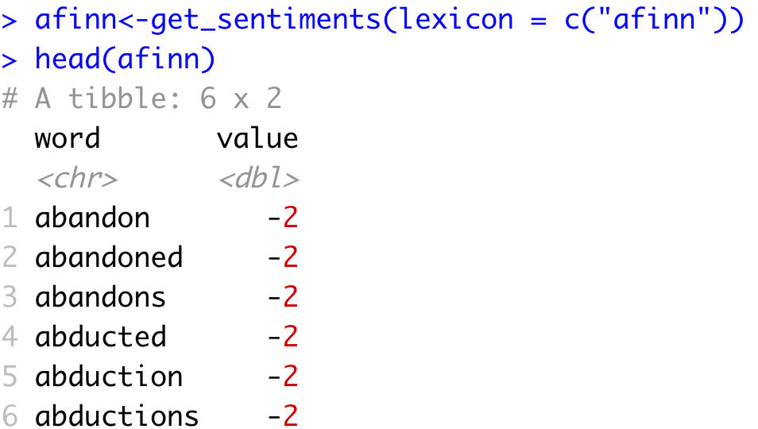
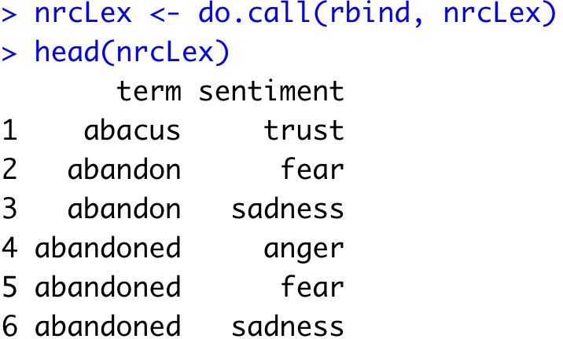
Sentiment the Tidy Way uses joins with existing lexicons
6782 Words
2477 Words
4463 Words

Slide 10
Tidy can seem complicated but not impossible.
The pipe operator
%>%
Forwards an object so the code is easy to understand & concise.
all.tidy <- all.tidy %>%
anti_join(stop_words)
Song text
Stop words
anti_join()
all.sentiment <- all.tidy %>%
inner_join(nrc.lexicon) %>%
count(tweet,sentiment) %>%
spread(tweet, n, fill = 0)
Sentiment
words
Song text
inner_join()

Slide 11
Starting with a DTM, its straightforward
# DTM
txtDTM <- DocumentTermMatrix(txtCorpus)
# Tidy
tidyCorp <- tidy(txtDTM)
# Get bing lexicon
bing <- get_sentiments(lexicon = c("bing"))
# Perform Inner Join
bingSent<-inner_join(tidyCorp,
bing, by=c('term'='word'))
DTM is from the “tm” library
Easy way to make it into a tibble.
Weeknd Lyrics
Bing Lexicon
* Due to some changes, the first time you use a sentiment lexicon, you will be asked to download. This is due to licensing.

Slide 12

Get in touch with our feelings…
Open B_sentimentAnalysis.R

Slide 13
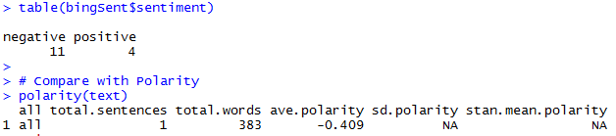
Similar polarity scores in both methods
Qdap’s polarity function calculates -0.409 for “Starboy” lyrics.

Slide 14

Similar polarity scores in both methods
Weeknd Lyrics
Bing Lexicon
Although less sophisticated & the scale is different, tidytext’s polarity is still negative

Slide 15
Let’s recreate Plutchik’s Wheel of Emotions
Back to the script!

